Slide 1
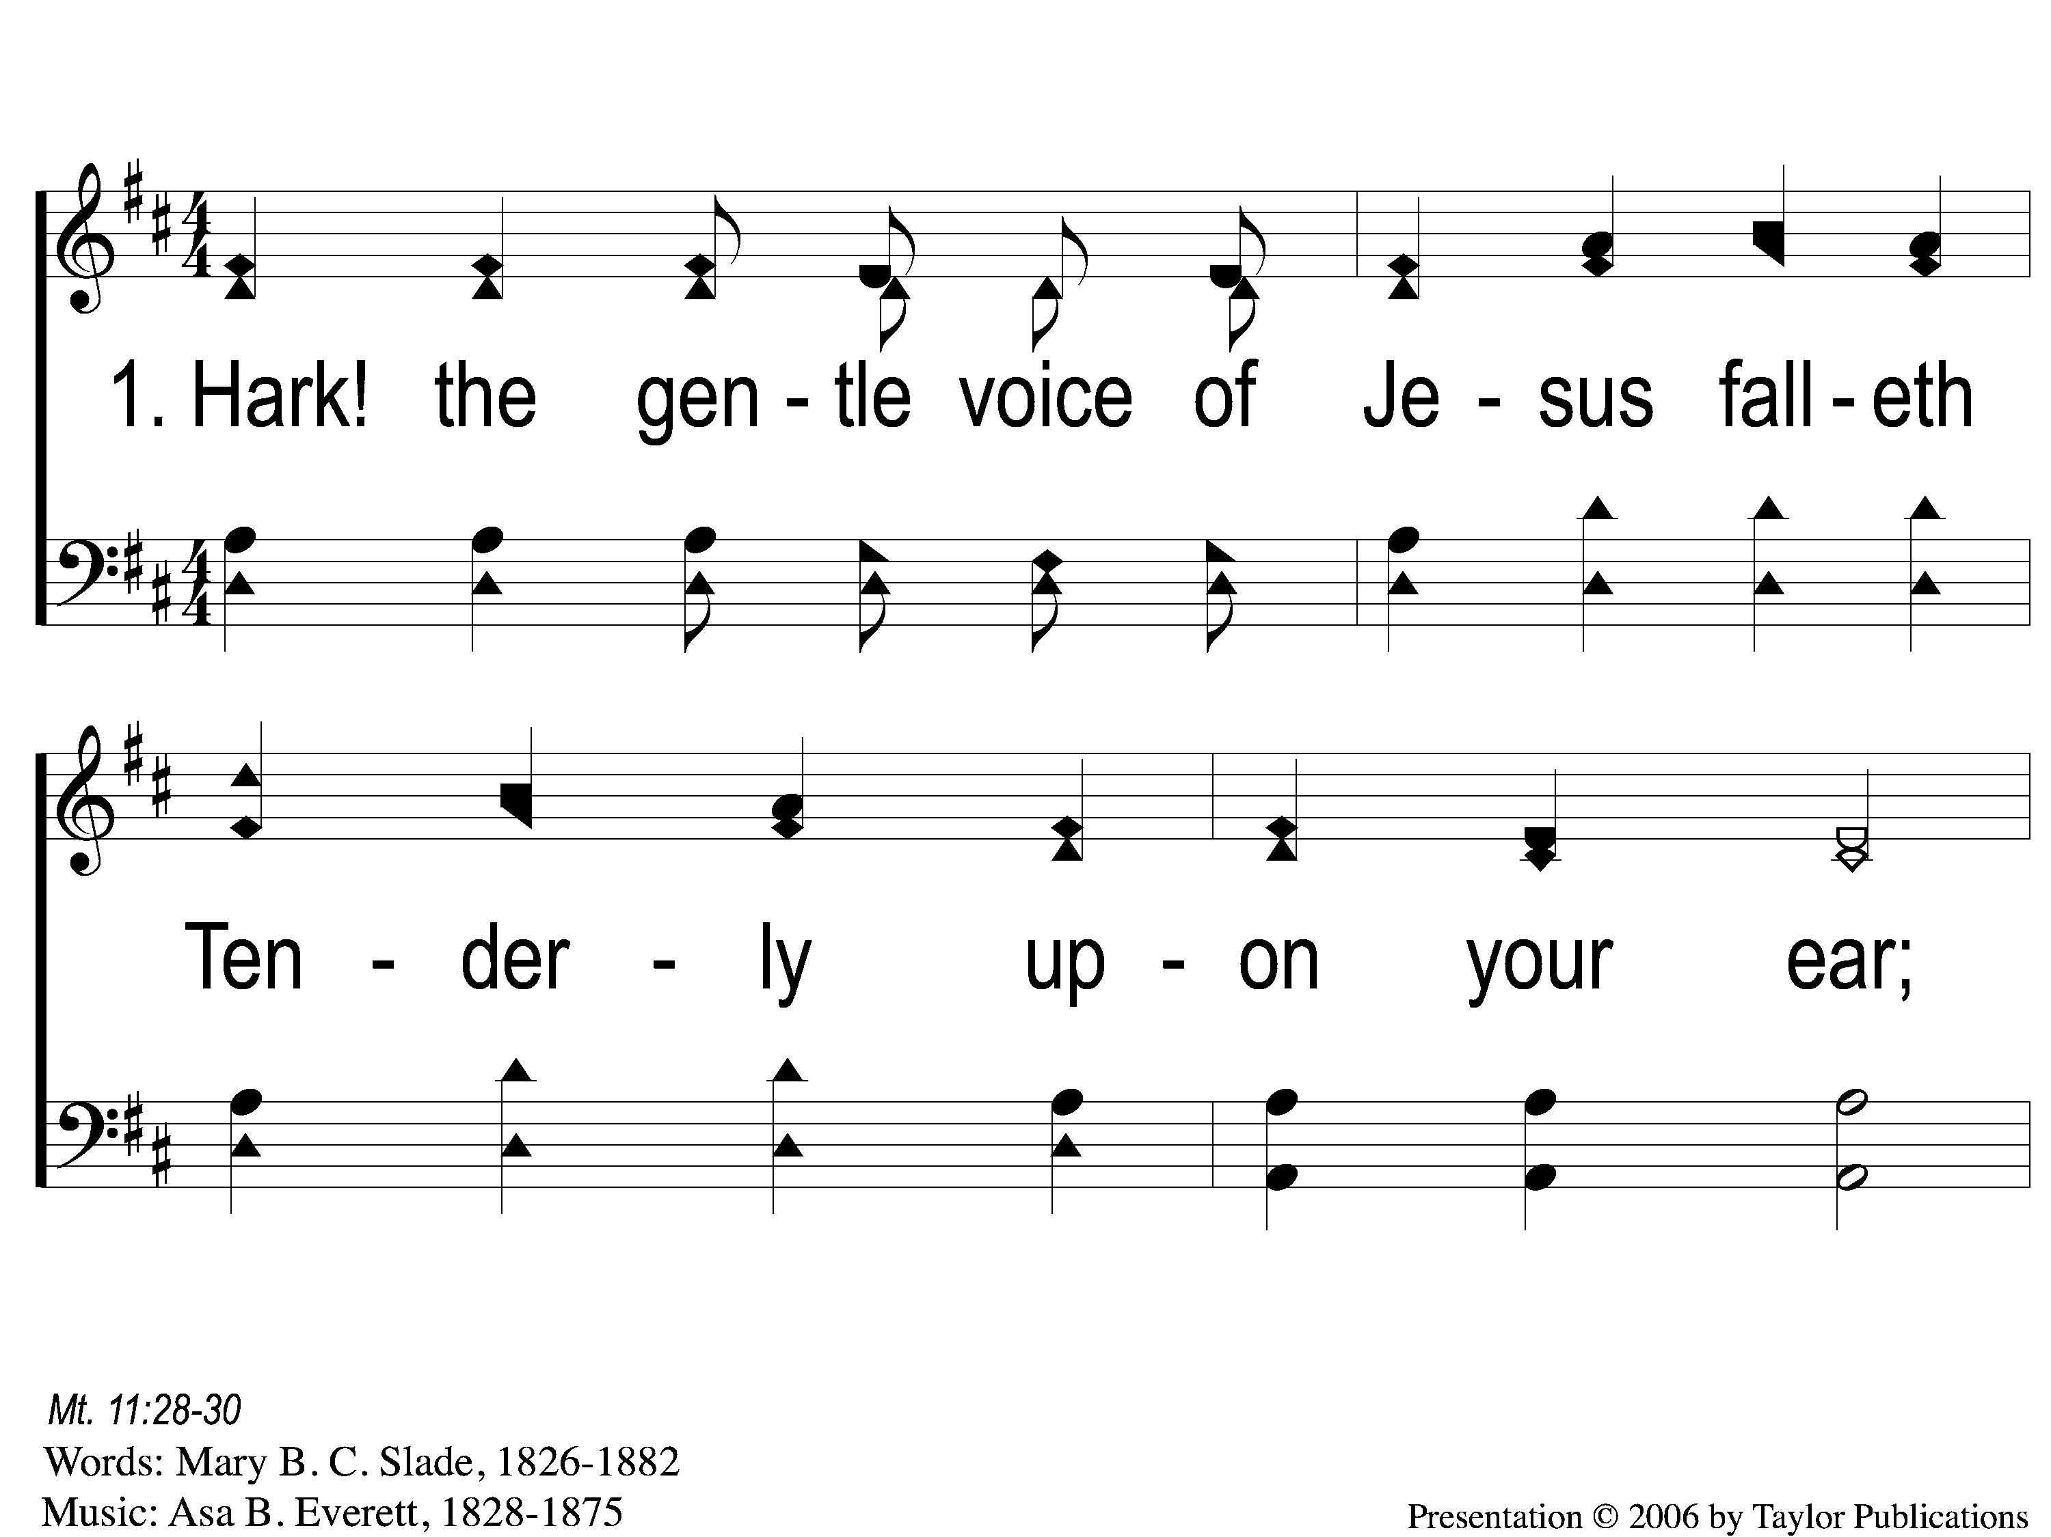
1-1 Hark the Gentle Voice
Hark The Gentle Voice
149

Slide 2
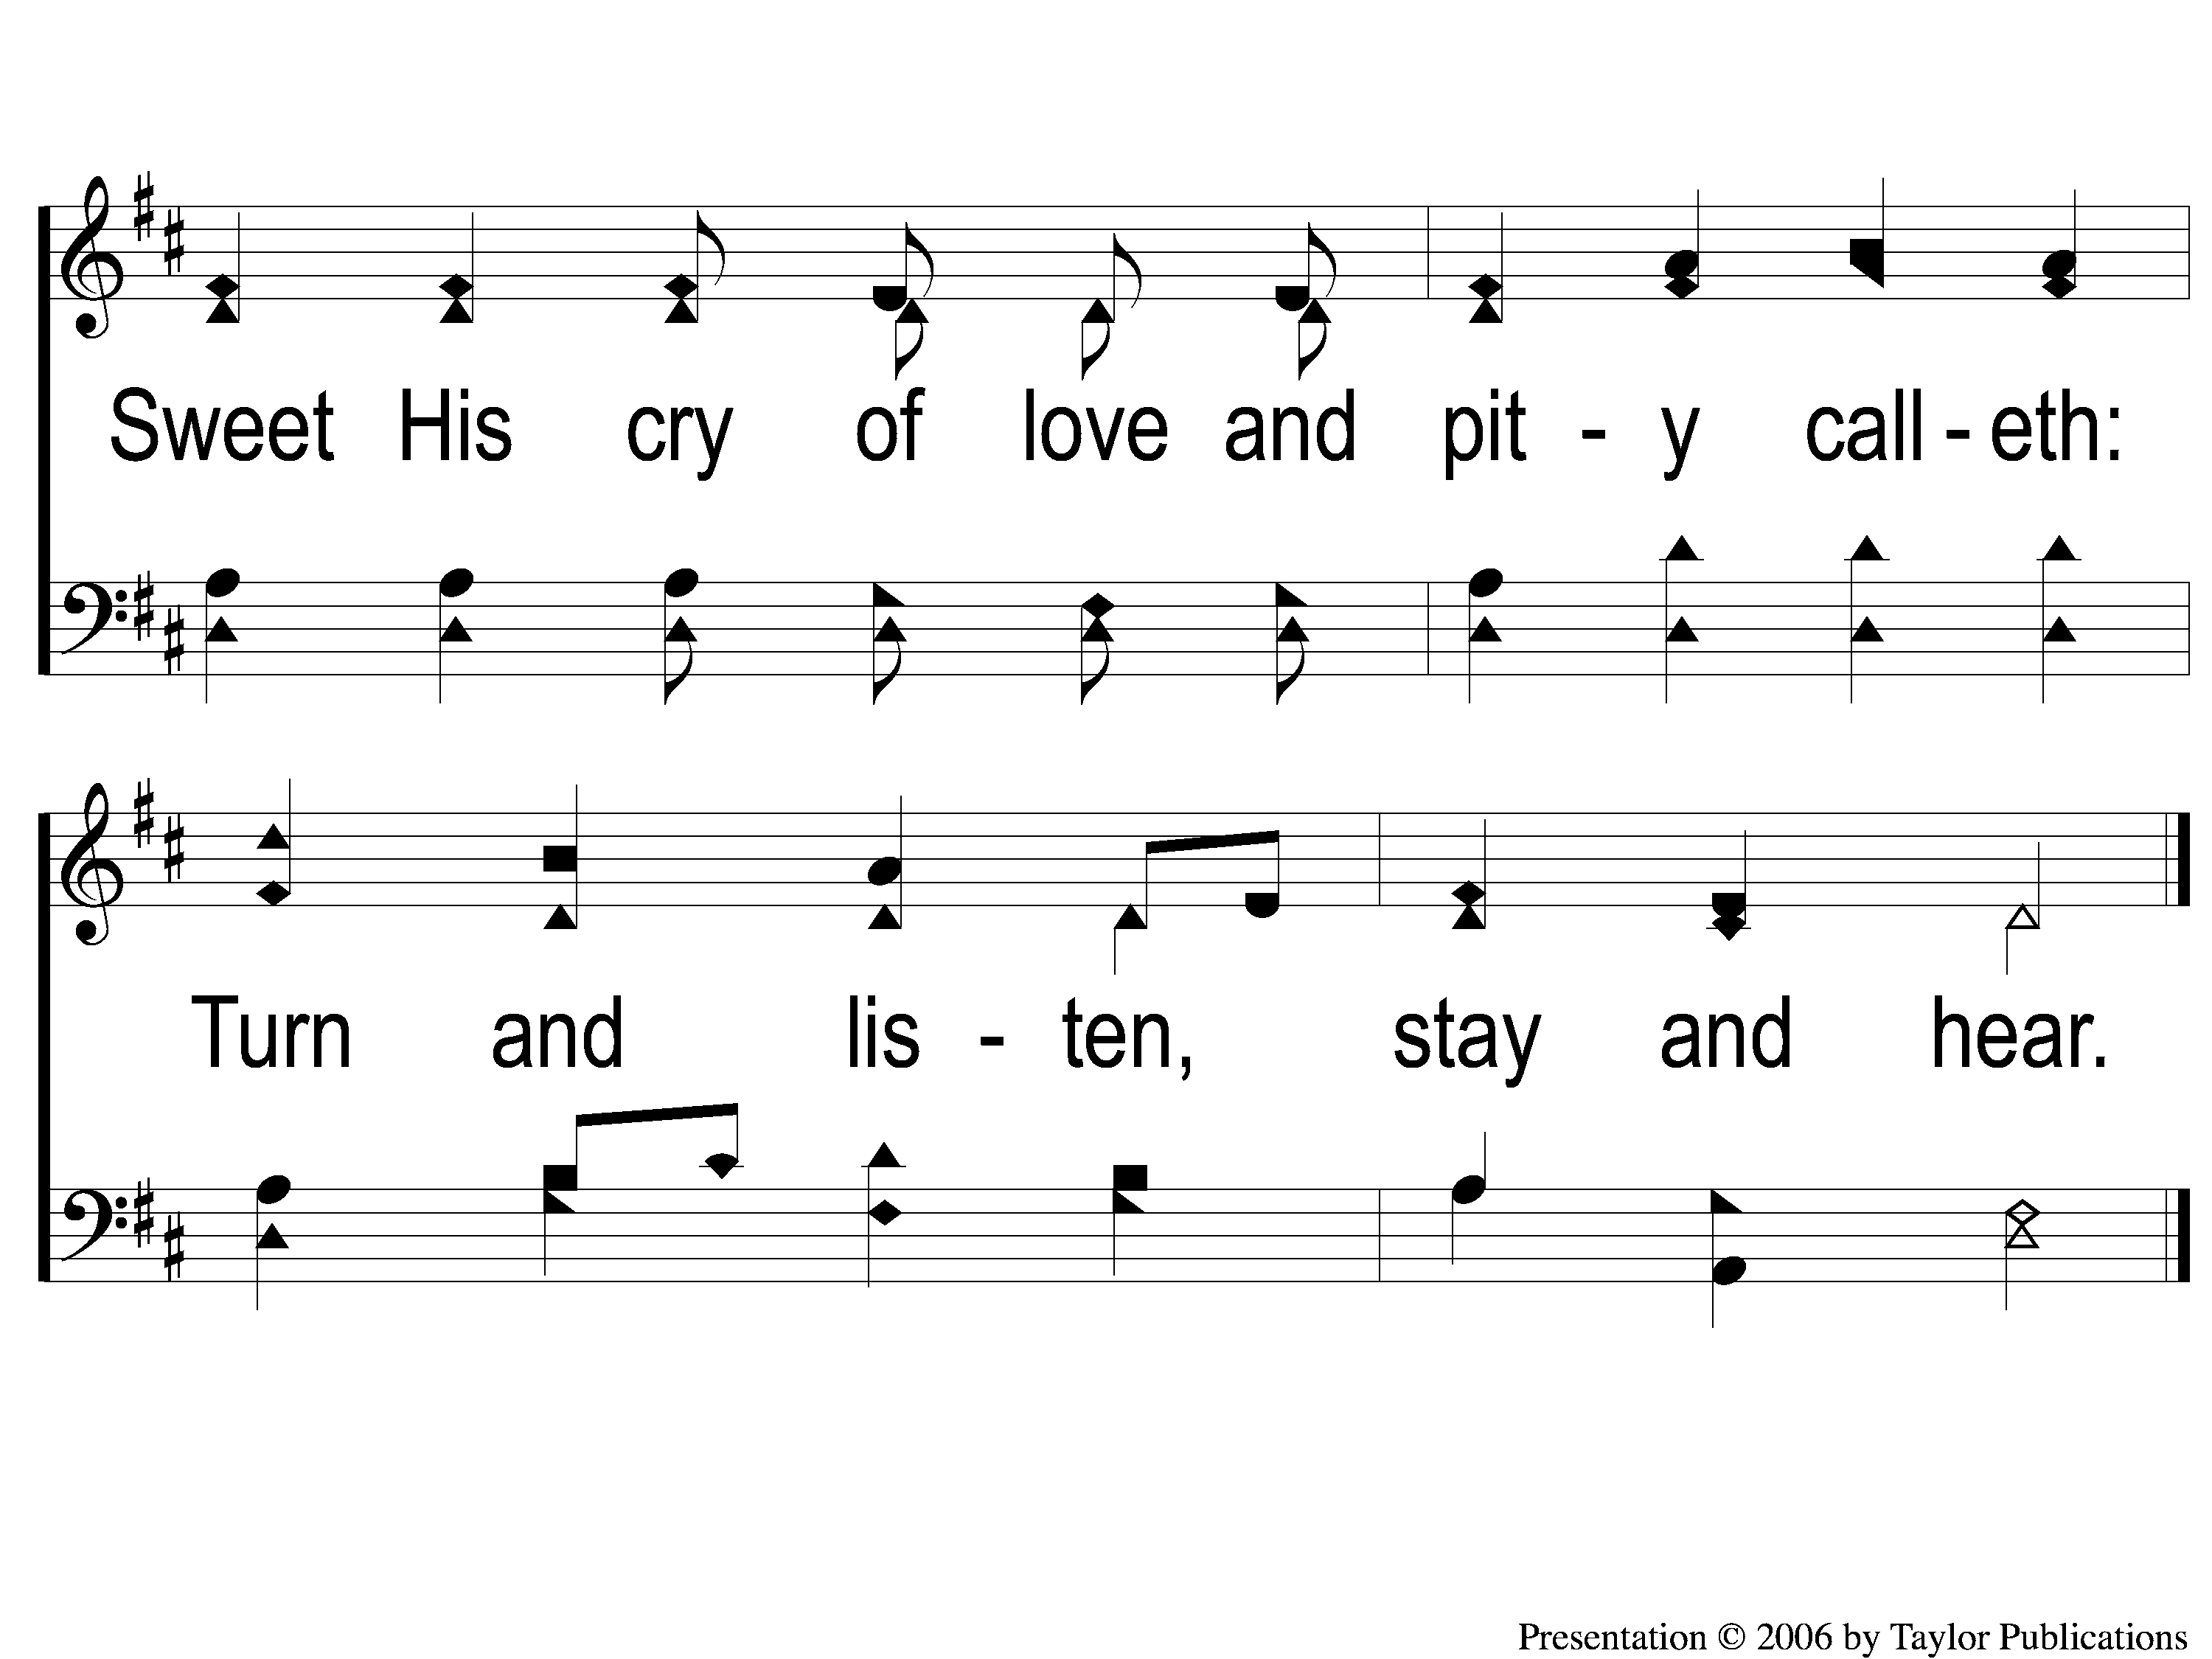
1-2 Hark the Gentle Voice
Hark The Gentle Voice
149

Slide 3
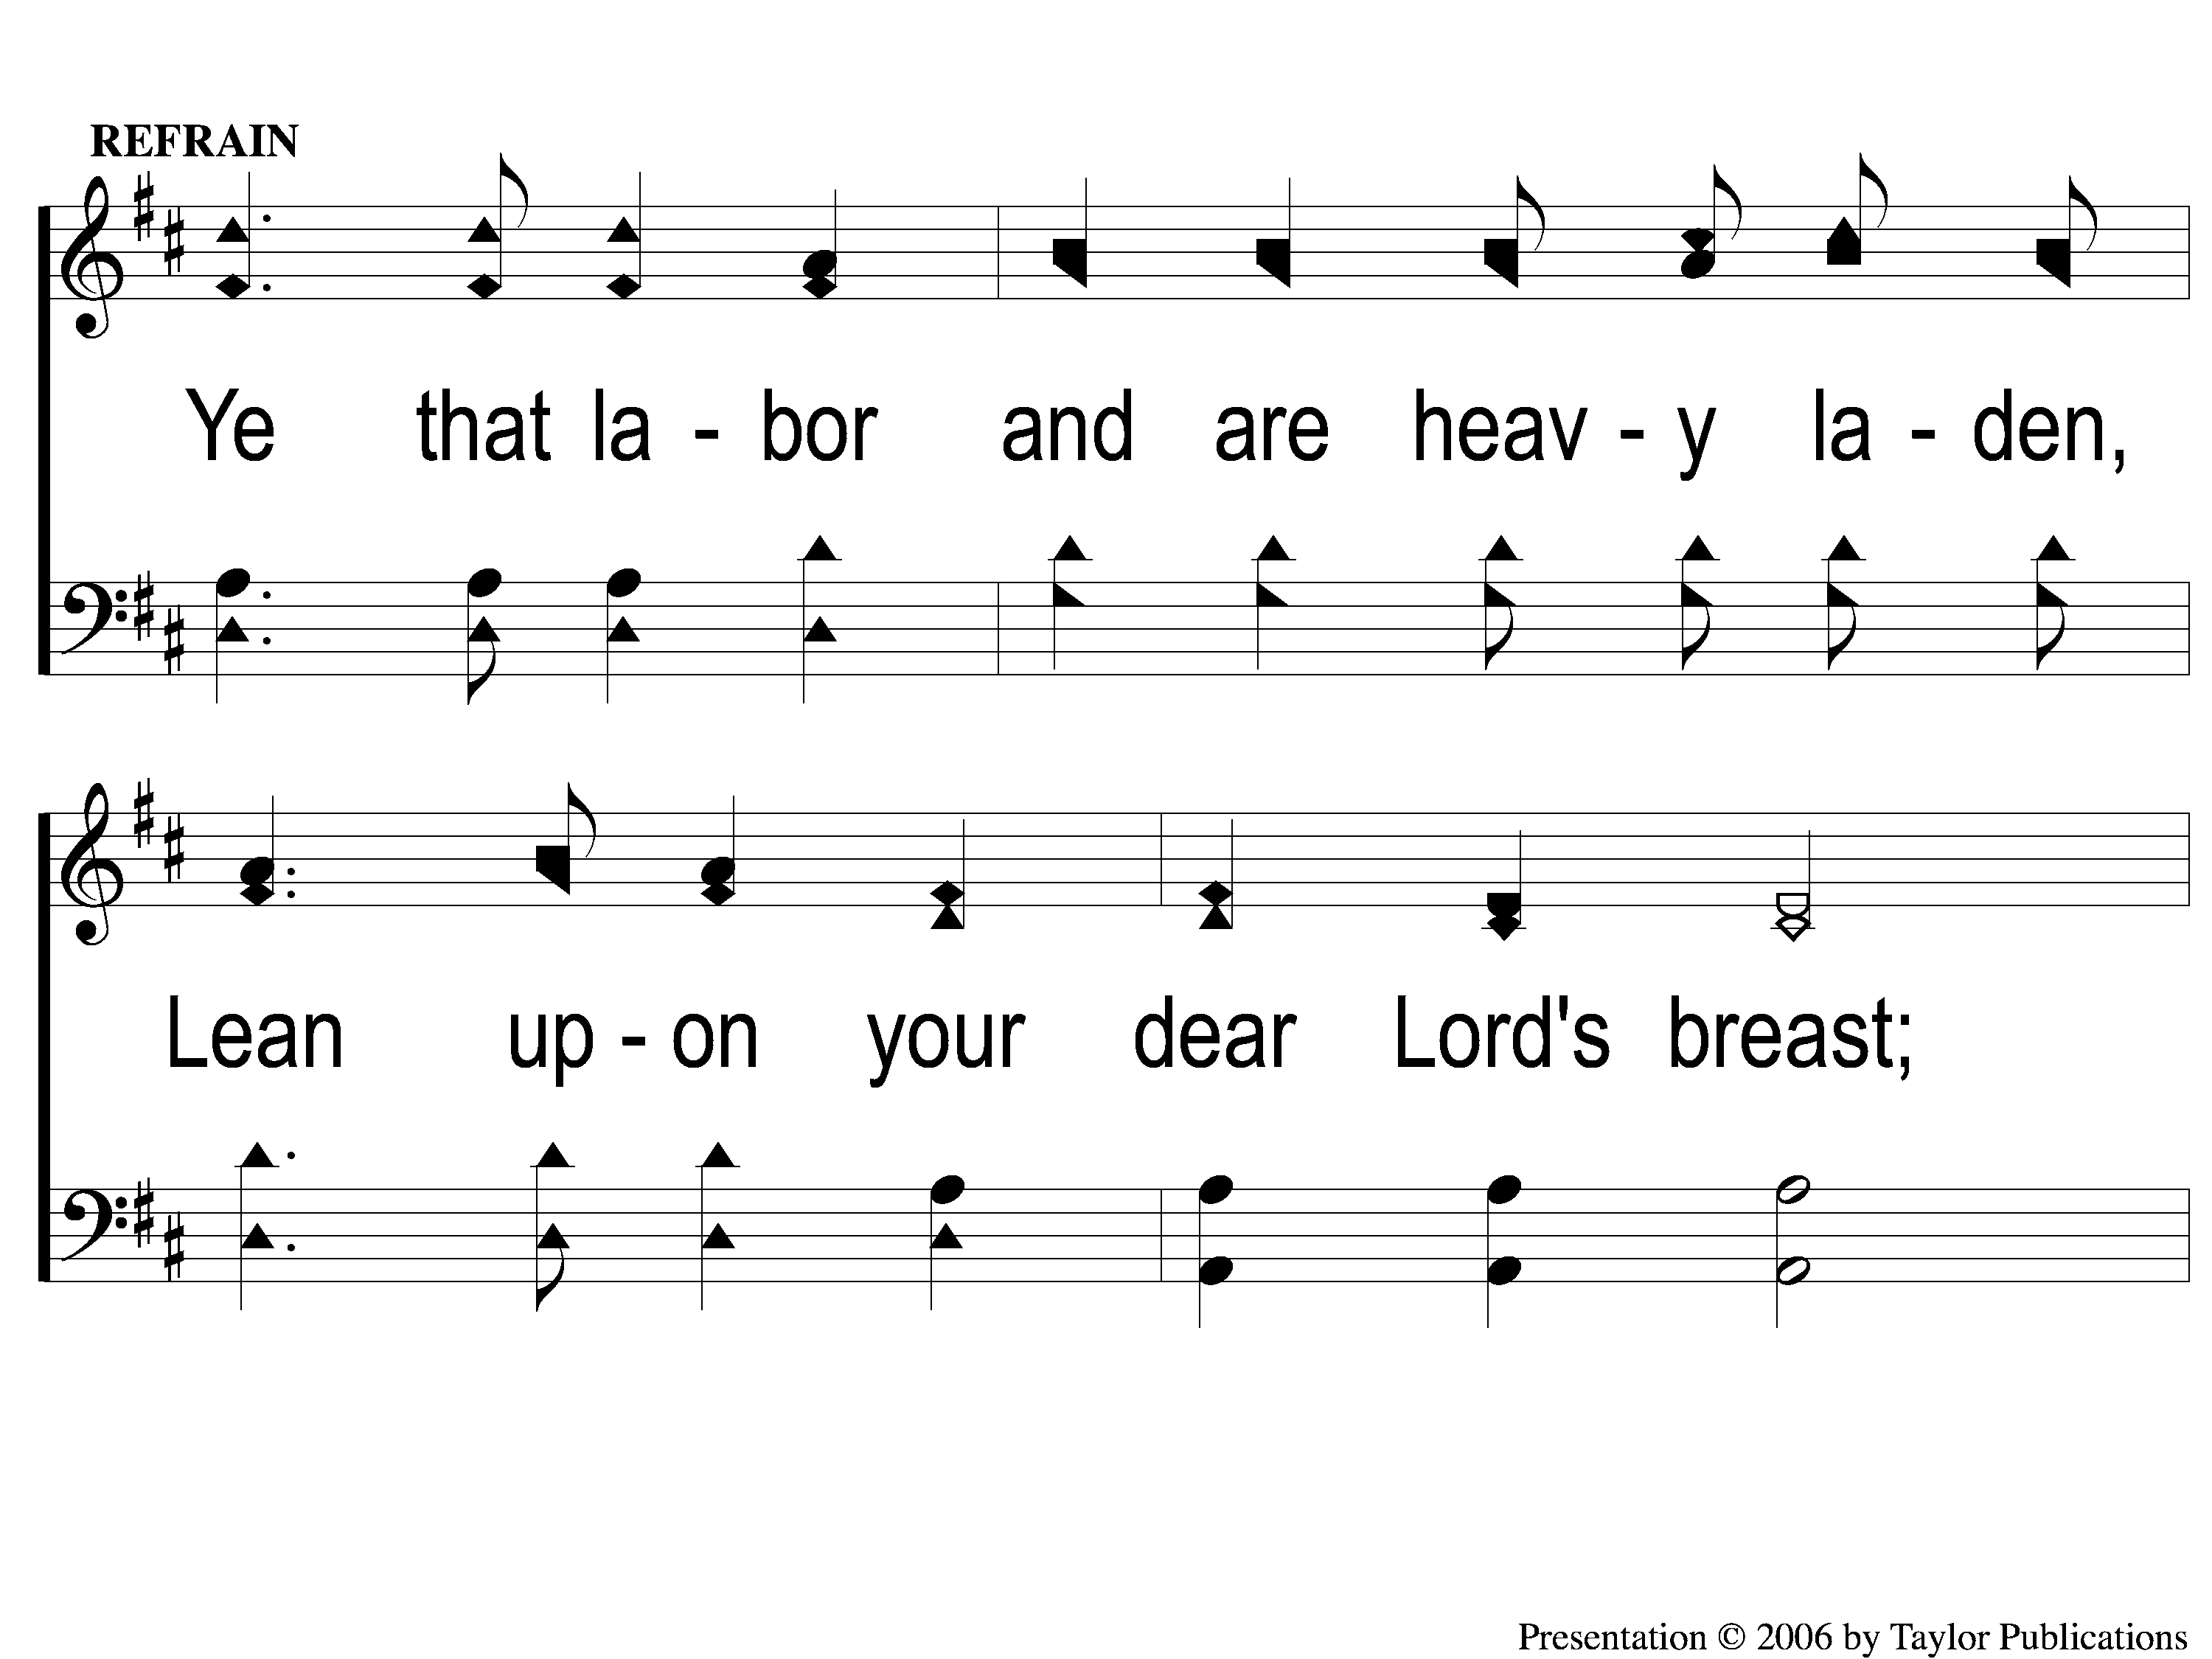
C-1 Hark the Gentle Voice
Hark The Gentle Voice
149

Slide 4
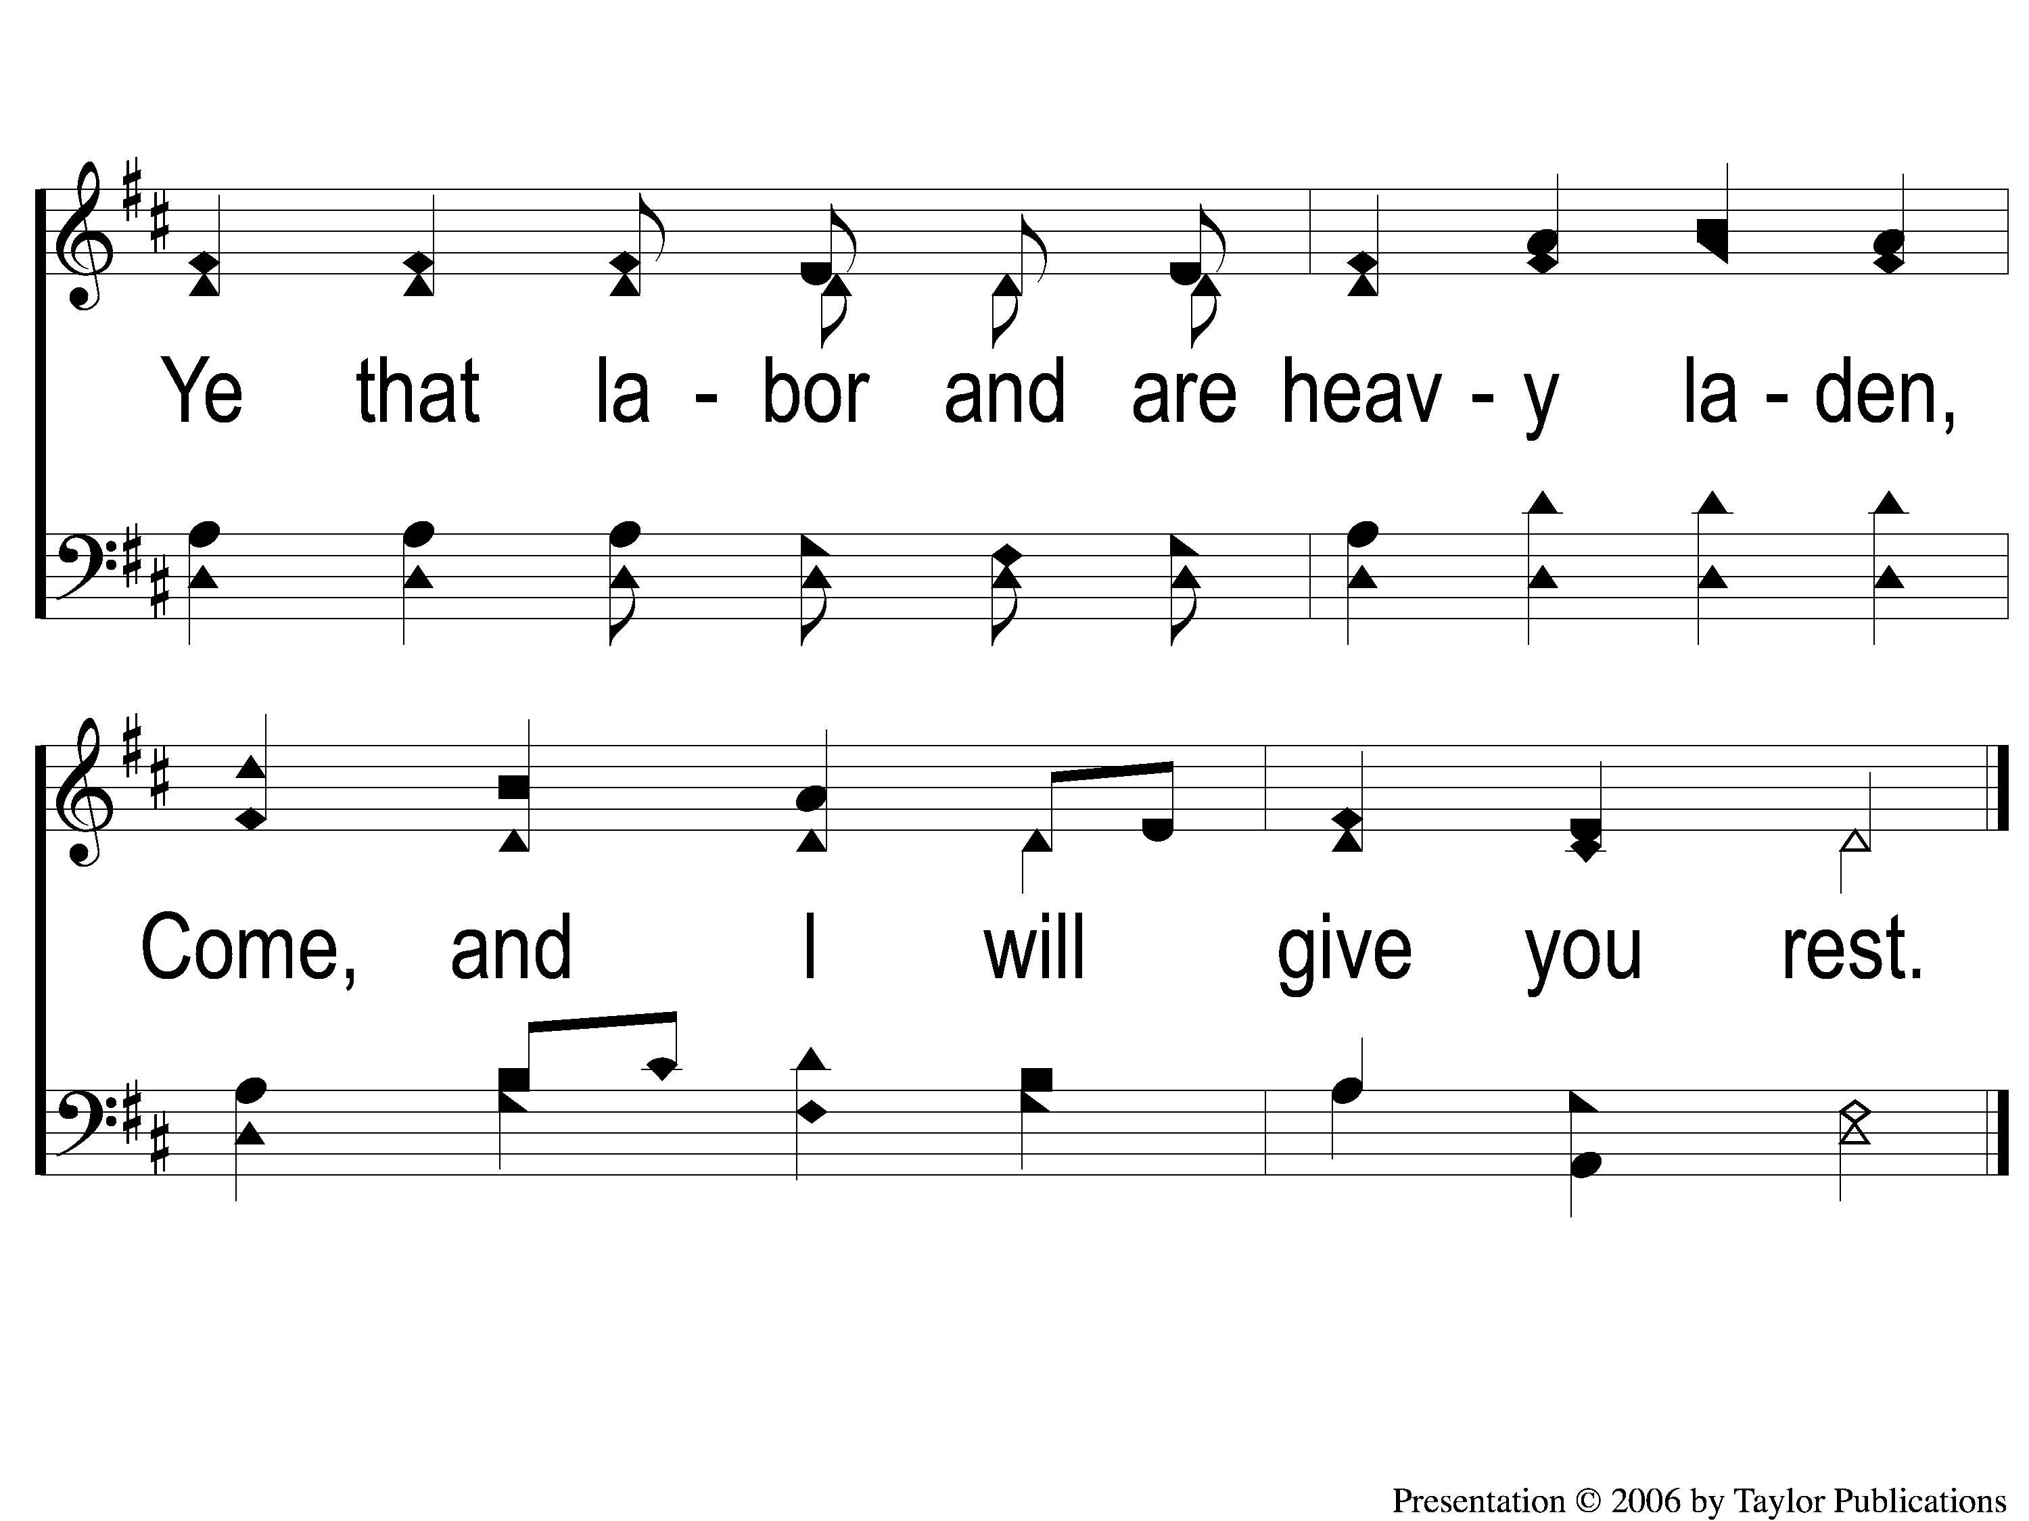
C-2 Hark the Gentle Voice
Hark The Gentle Voice
149

Slide 5
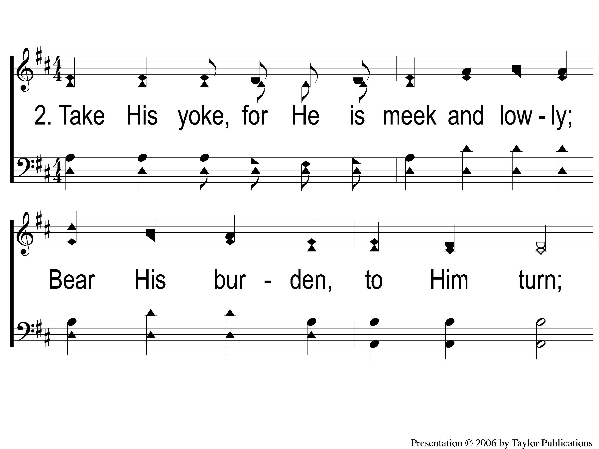
2-1 Hark the Gentle Voice
Hark The Gentle Voice
149

Slide 6
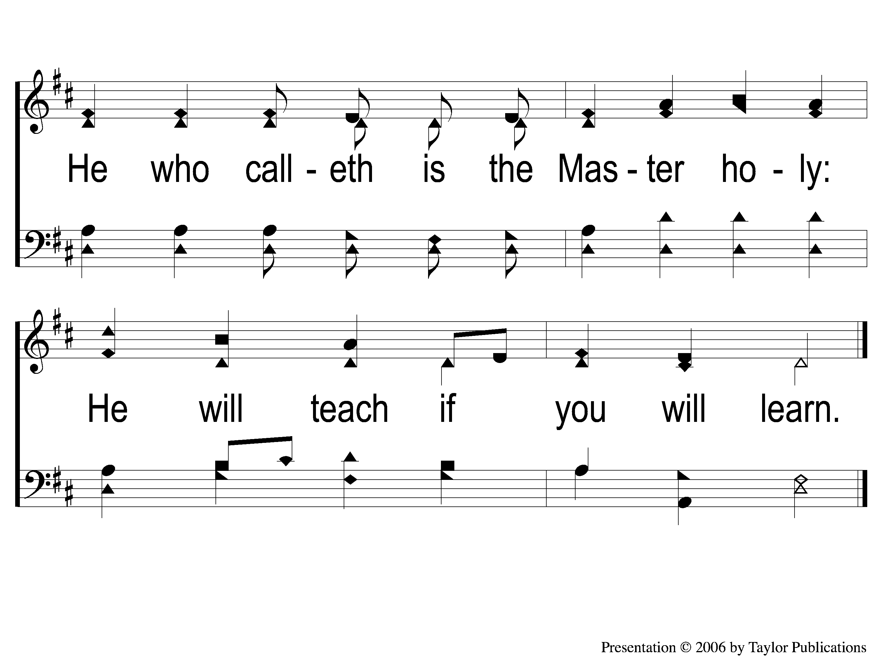
2-2 Hark the Gentle Voice
Hark The Gentle Voice
149

Slide 7
C-1 Hark the Gentle Voice
Hark The Gentle Voice
149

Slide 8
C-2 Hark the Gentle Voice
Hark The Gentle Voice
149

Slide 9
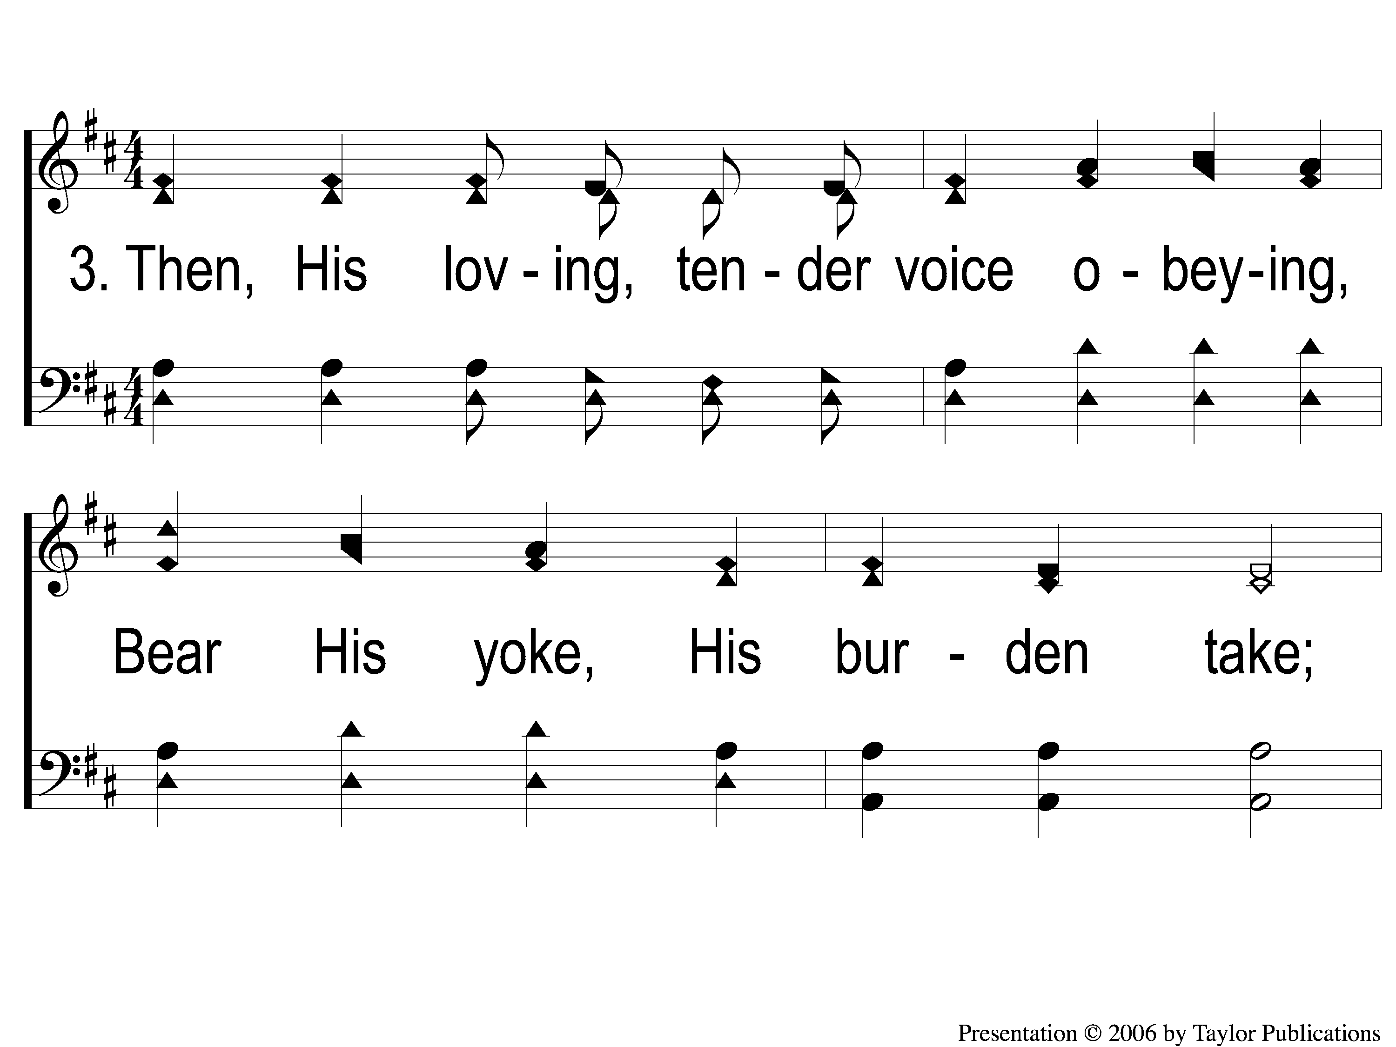
3-1 Hark the Gentle Voice
Hark The Gentle Voice
149

Slide 10
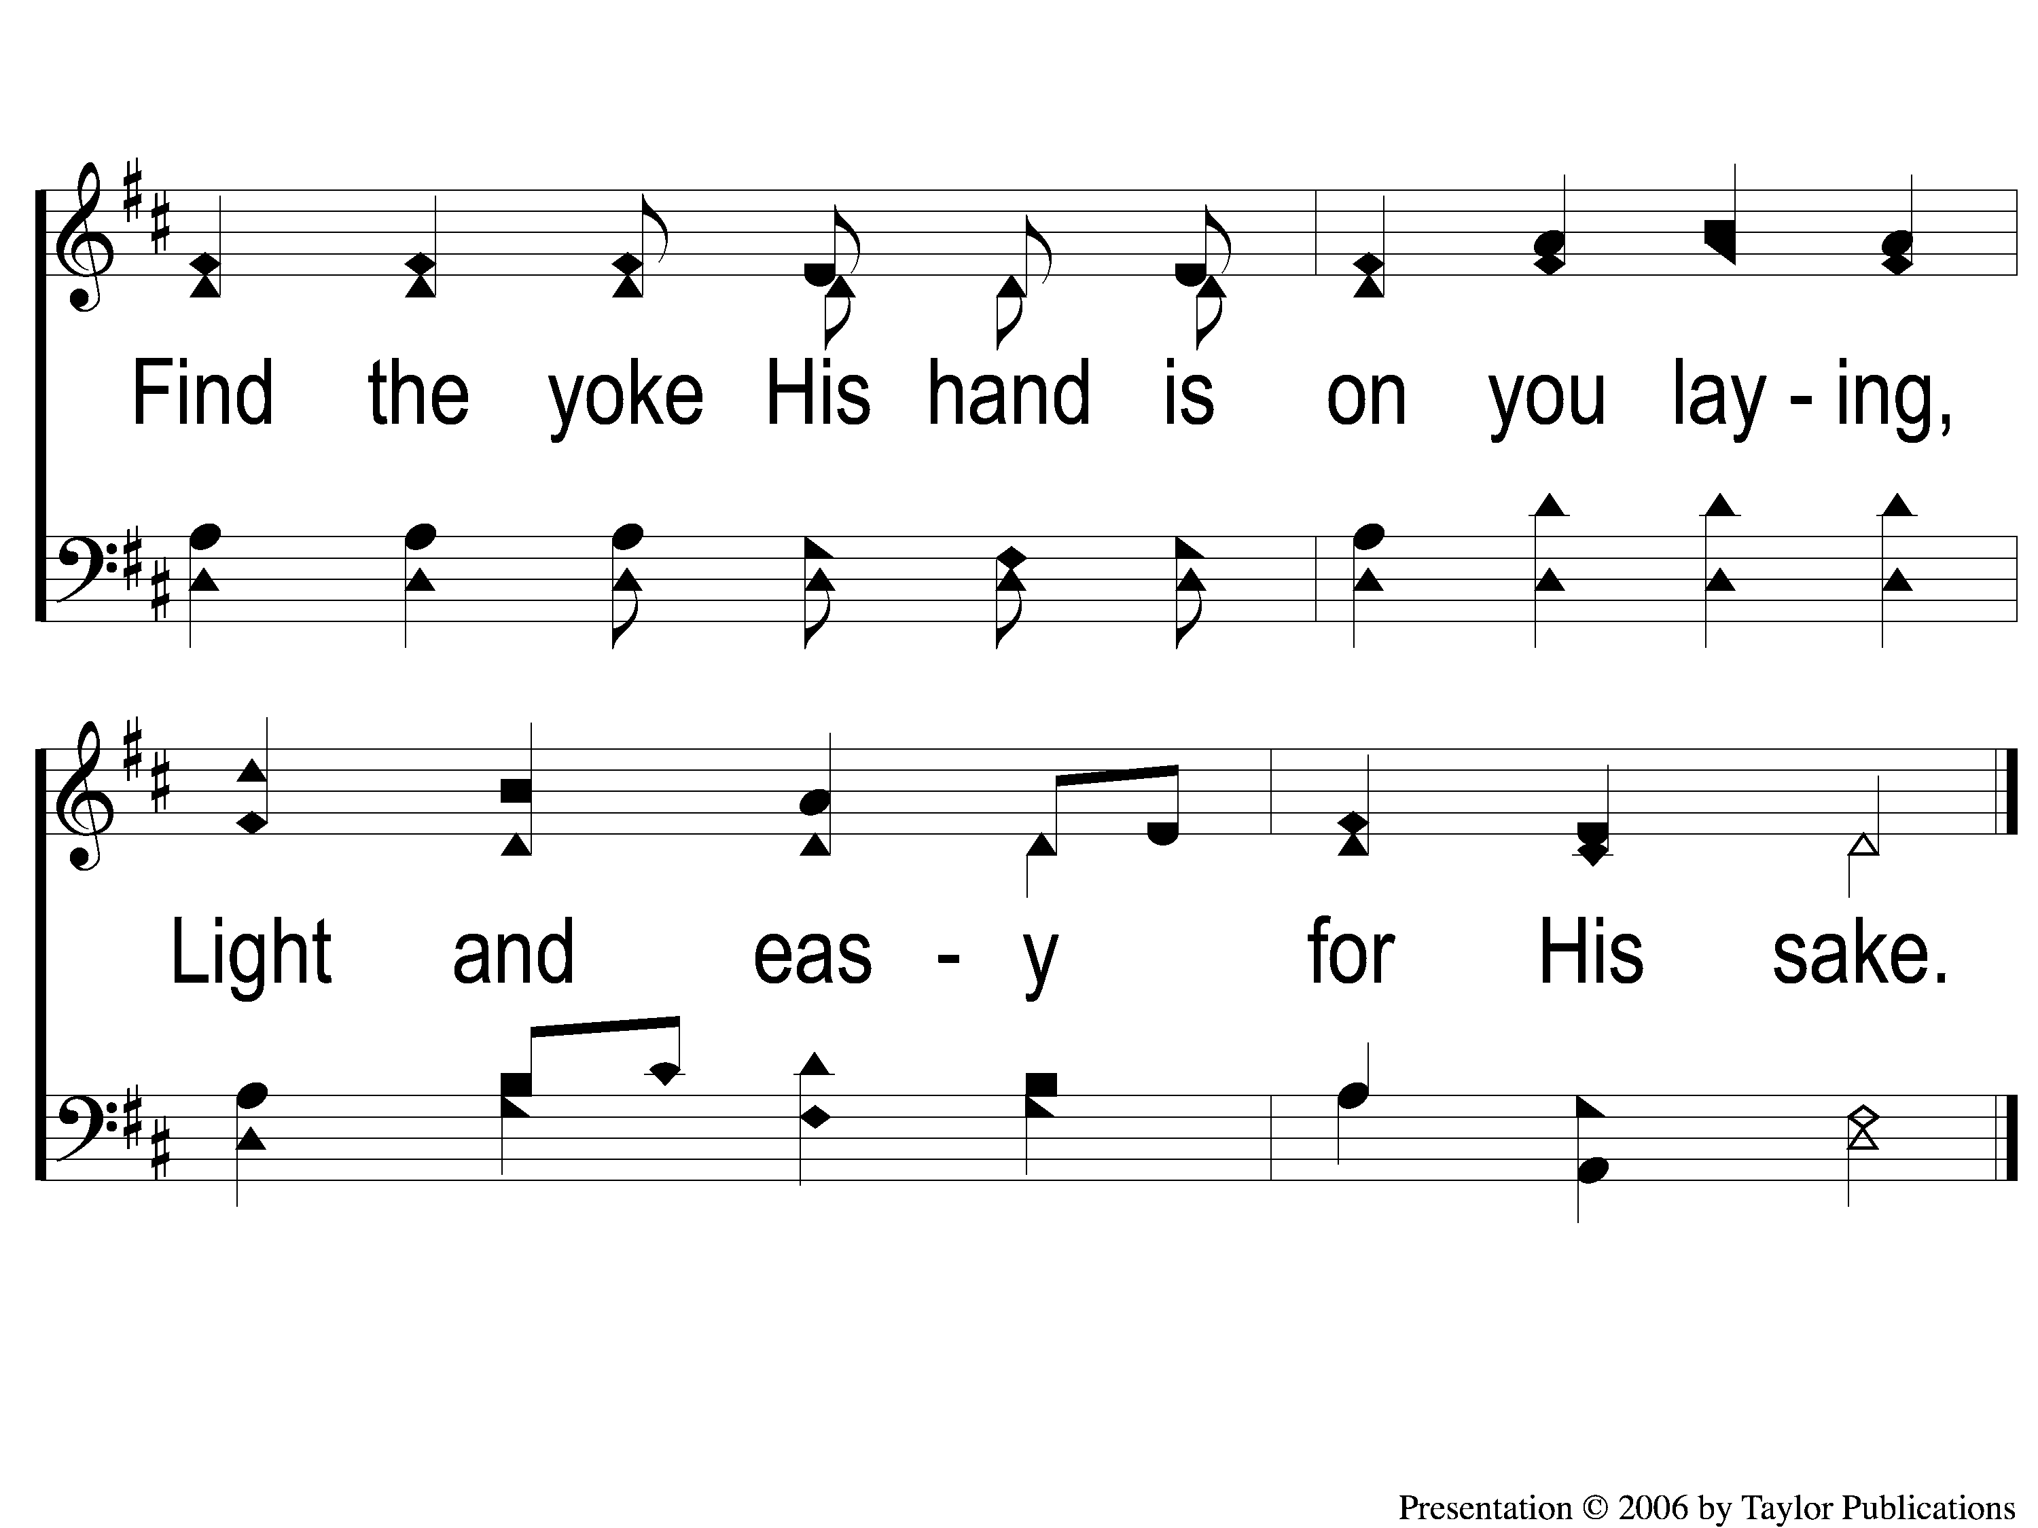
3-2 Hark the Gentle Voice
Hark The Gentle Voice
149

Slide 11
C-1 Hark the Gentle Voice
Hark The Gentle Voice
149

Slide 12
C-2 Hark the Gentle Voice
Hark The Gentle Voice
149

